Slide 1

+++++++++++
AUTOMATED PLANT WATERING SYSTEM USING ARDUINO

Slide 2

TEAM MEMBERS
LAKSHMI - CB.SC.U4AIE24116
SRINIVAS - CB.SC.U4AIE24140
MYAGI - CB.SC.U4AIE24143
SRI SHANMATHI - CB.SC.U4AIE24152

Slide 3
INTRODUCTION
Plants require regular watering to stay healthy.
Manually watering plants can be inconvenient.
This system automates watering based on soil moisture levels.
Uses Arduino, soil moisture sensor, relay module, and LCD display.

Slide 4
OBJECTIVE
Automated Irrigation: Implement an intelligent system that autonomously waters plants based on real-time soil moisture readings, ensuring optimal hydration.
Efficient Water Management: Develop a smart water distribution mechanism that minimizes wastage and prevents overwatering through precise control.

Slide 5
COMPONENTS
Arduino Uno (Microcontroller)
Soil Moisture Sensor (Detects moisture level in soil)
Relay Module (Controls water pump)
Water Pump (Pumps water to the plant)
LCD Display (16x2) (Shows moisture level and system status)
Breadboard & Jumper Wires (For connections)
Power Supply

Slide 6
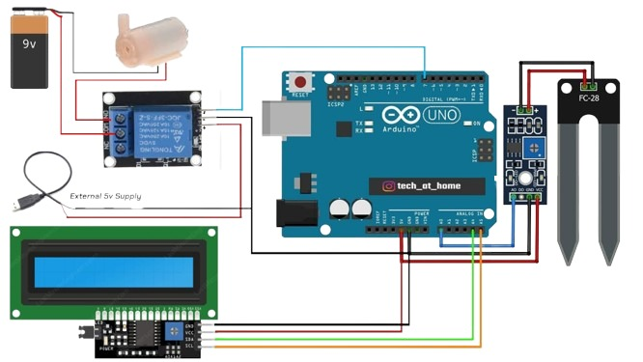
CIRCUIT DIAGRAM

Slide 7
Connections
Component | Pin | Connected To (Arduino/Others) | Why this connection?
Power Rails | + (Positive) | 5V (Arduino) | Provides power to all components
 | - (Negative) | GND (Arduino) | Completes the circuit ground
DHT Sensor | VCC | 5V (Arduino) | Powers the sensor
 | GND | GND (Arduino) | Completes the circuit ground
 | A0 | A0 (Arduino) | Sends moisture levels to Arduino
LCD Display | VCC | 5V (Arduino) | Powers the display
 | GND | GND (Arduino) | Completes the circuit ground
 | SDA | A4 (Arduino) | Sends data to display
 | SCL | A5 (Arduino) | Sends clock signal to display

Slide 8
Component | Pin | Connected To (Arduino/Others) | Why this connection?
Battery | + (Positive) | Common Terminal of Relay | Provides power to the pump
 | - (Negative) | Negative of Pump | Completes the pump circuit
Relay Module | VCC | 5V (Arduino) | Powers the relay
 | GND | GND (Arduino) | Completes the circuit ground
 | IN | Digital Pin 7(Arduino) | Controls the relay switching
Pump | Positive Wire | Open Terminal of Relay | Activates the pump when relay is switched

Slide 9
METHODOLOGY
A soil moisture sensor is placed in the soil to measure moisture levels.
The sensor outputs an analog voltage corresponding to the moisture content.
The Arduino reads this analog value via the A0 pin.
The microcontroller processes the sensor data.
The system follows predefined thresholds to determine soil moisture conditions:
DRY SOIL- MOTOR ON
MEDIUM MOISTURE- WORKS
WET SOIL- MOTOR OFF

Slide 10
ADVANTAGES
Reduces manual effort in watering plants.
Saves water by optimizing irrigation.
Prevents overwatering or underwatering.
Useful for home gardens, agriculture, and smart farming.

Slide 11


